Slide 1




Starting Now
The Golden Age of Hype: What Today’s AI Moment Gets Wrong-- and What Comes Next
I
A grounded, fast-paced journey through the real history and economics behind today’s AI moment
What’s really going on when we find clarity in the hype
Lessons from past bubbles, failed pilots, and current case studies—designed to help leaders separate signal from noise
A strategic framework for GenAI 2.0: shifting from hype to value, and from automation to intelligent augmentation
Stephen Klein
Founder & CEO, Curiouser.AI;
Lecturer, UC Berkeley
Notes:
‹#›

Slide 2

The Golden Age of Hype: What Today’s AI Moment Gets Wrong-- and What Comes Next
‹#›

Slide 3
About Stephen Klein
Stephen Klein is the Founder and CEO of Curiouser.AI, a values-driven AI advisory helping leaders use generative AI to think more clearly, design with intention, and lead with imagination.
He also teaches at UC Berkeley, exploring the intersection of strategy, ethics, and emerging tech.
A Harvard MBA and three-time entrepreneur, Klein brings global experience across startups, F500s, and higher ed. Formerly CMO at Dentons’ innovation arm, he led global AI ethics efforts.
He is currently working with Georgetown University Press Publishing to author a book called Age of Meaning: What Life Look Likes In A Post Automation World
At Curiouser, he’s building Alice™, an AI strategic coach that supports thoughtful decision-making. His message: AI isn’t just about tecd- it’s about better questions, stronger values, and more human leadership.
Stephen Klein
Founder & CEO, Curiouser.AI;
Lecturer, UC Berkeley
Notes:
‹#›

Slide 4

01
The Three Hidden Forces
Agenda
02
Force One- Mass Delusion
03
Force Two- Cognitive Theatre
04
Force Three- Metaphorical Confusion
05
Welcome to The Age Of Meaning
Notes:
‹#›

Slide 5

The Three Hidden Forces
To understand what’s really going on with AI, you must be able to see three invisible forces
>

Slide 6
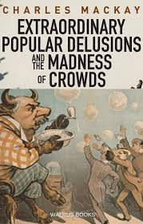
Force One — Mass Delusions & the Madness of Crowds
Humanity’s Collective Ability to be Seduced by Greed
1637: Dutch Tulip Mania
1999: Dot-com bubble
2008: Real estate crash
2025: GenAI? Massive losses, no profitability
OpenAI reportedly loses $1B/month
>

Slide 7

Force One — Mass Delusions & the Madness of Crowds
Striking Similarities
GenAI companies losing billions
No moats
Commodities
Upside down unit economics
Inverse scales of economy
Products increasingly unreliable
>

Slide 8

Force Two — Synthetic Narratives (Cognitive Theater)
When An Industry Blinds Us to The Truth
A well-used and finely honed marleting playbook
In the 1950s- Sugar
In the 1990s- Tobacco
Fund studies, buy credibility, create FOMO
Influencers amplify manufactured "truth"
80% of GenAI "success data" is industry-sourced
>

Slide 9
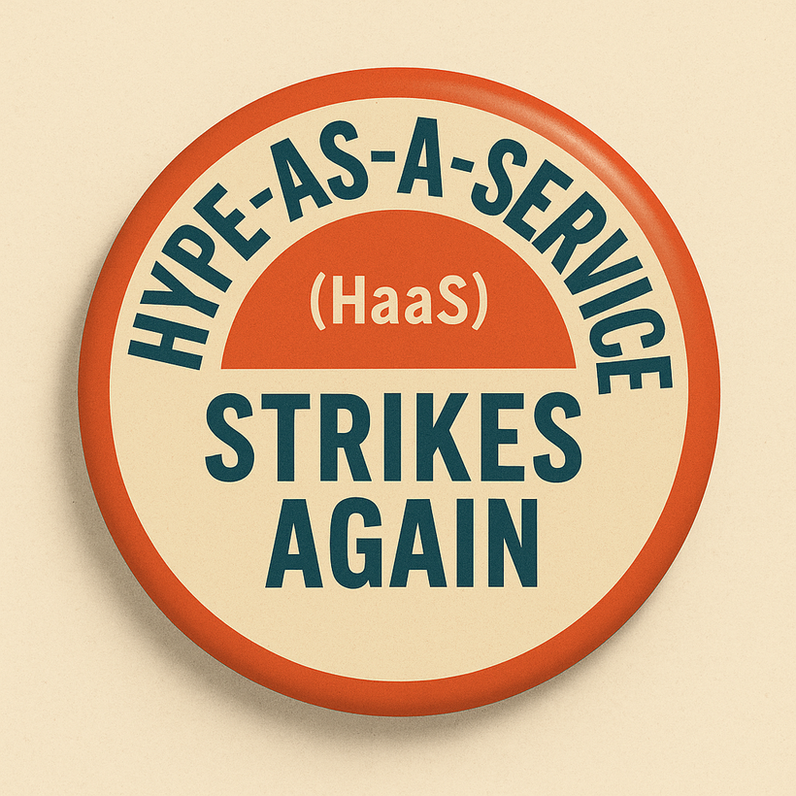
Force Two — Synthetic Narratives (Cognitive Theater)
Delusions Require Cognitive Theatre
Hype drives expectations
Hype drives the consulting industry revenue
Hype drives fundraising and valuations
Hype drives the Ponzi Schemes (perfectly legal)
Hype floods the zones and keeps us off-balance
>

Slide 10

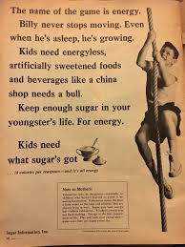
Force Two — Synthetic Narratives (Cognitive Theater)
>

Slide 11
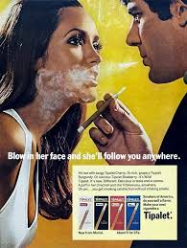
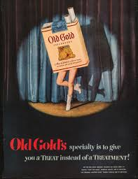
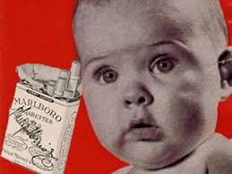
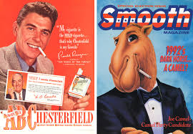
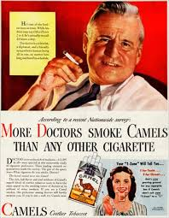
Force Two — Synthetic Narratives (Cognitive Theater)
>

Slide 12
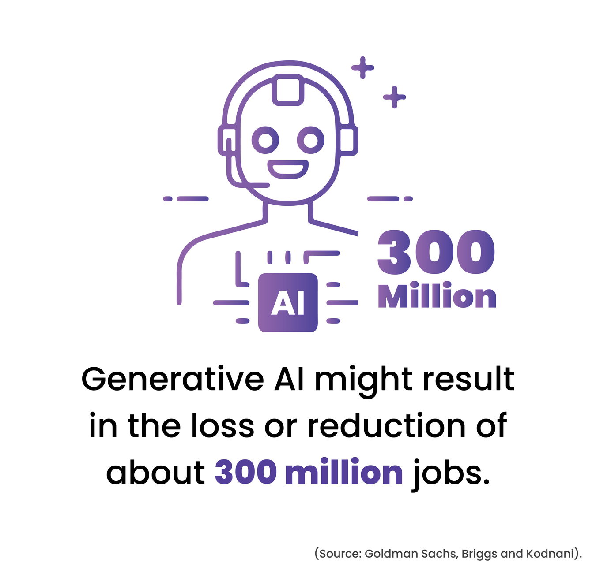
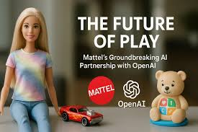
Force Two — Synthetic Narratives (Cognitive Theater)
>

Slide 13
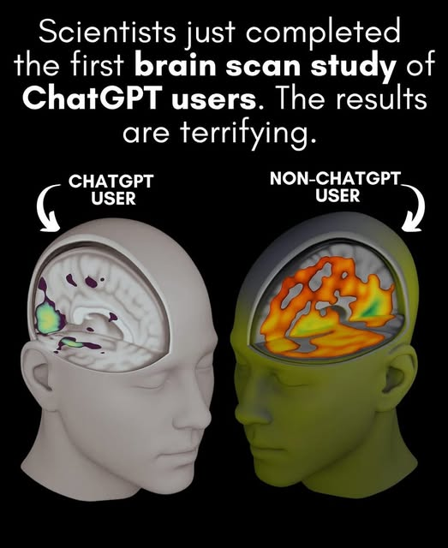
Force Two — Synthetic Narratives (Cognitive Theater)
>

Slide 14
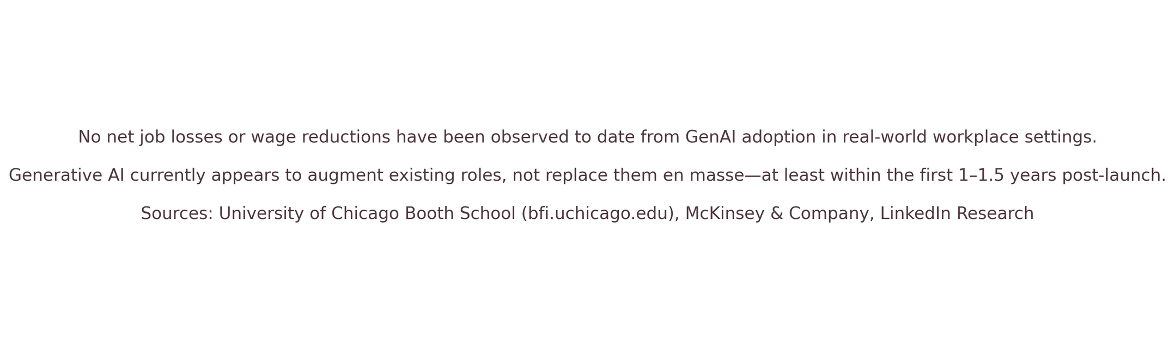
Force Two — Synthetic Narratives (Cognitive Theater)
>

Slide 15
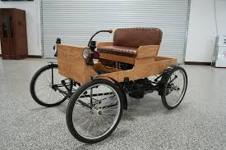
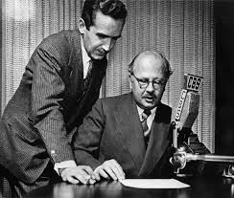
Force Three — Metaphorical Confusion
The Metaphorical Paradox
We always get new tech wrong
>

Slide 16

Force Two — Synthetic Narratives (Cognitive Theater)
What is Generative AI?
Tool
Intern
Partner
Therapist
Friend
Coach
>

Slide 17
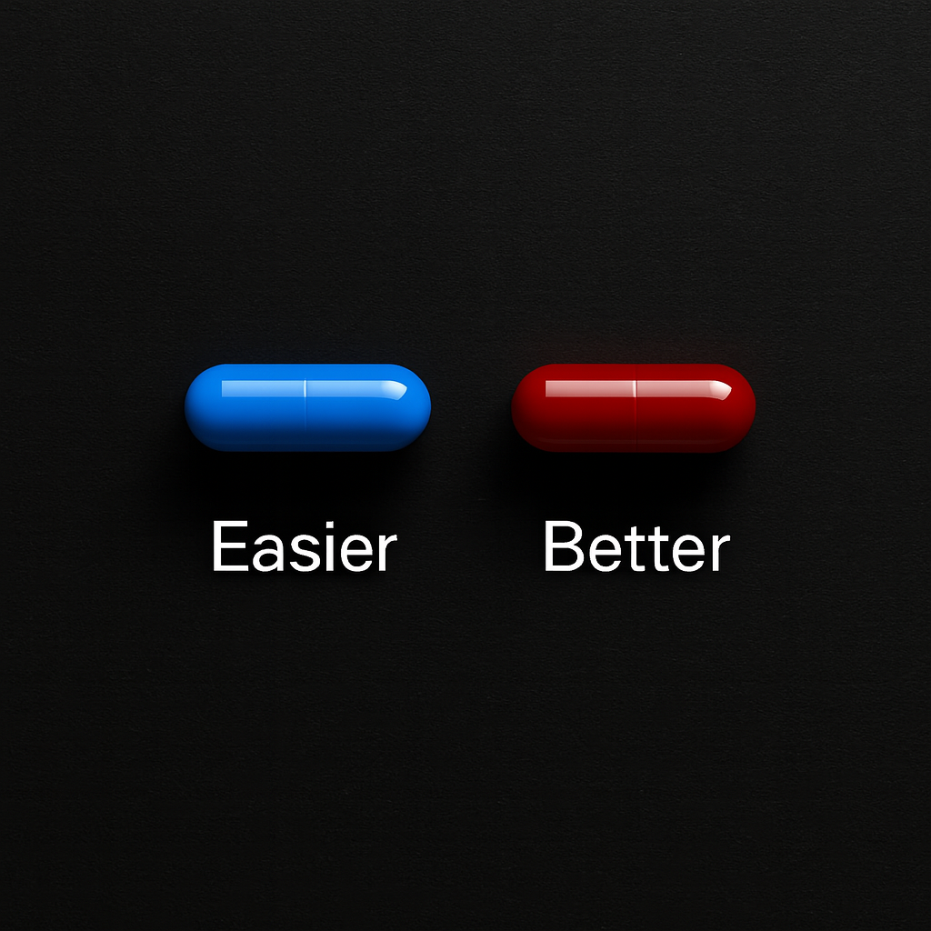
Force Three — Metaphorical Confusion
>

Slide 18

Age of Meaning
The Reality of Today’s GenAI Implementation
20% of all pilots currently scale (McKinsey)
Just 3% of executives say their GenAI efforts have delivered “significant value.” (Korn Ferry)
The #1 barrier to adoption isn’t technology—it’s organizational alignment and leadership. (MIT Sloan)
60% of AI budgets go to vendor lock-in and consulting, not capability building. (Accenture)
>

Slide 19

The Age of Meaning — A New Strategic Era
Welcome to the
The Age of Meaning
>

Slide 20
Age of Meaning
Pre-Automation: Porter’s 5-Forces
Threat of
New Entrants
Barriers to Entry
Bargaining Power of Suppliers
Industry
Rivalry
Bargaining Power of Buyers
Switching Costs
Threat of Substitutes
>

Slide 21
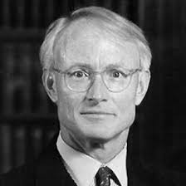
Age of Meaning
Porter’s 5 Forces No Longer Apply
Post-IP world: 90% of Internet scraped
Post-Regulation: Policy lagging behind innovation
Post-Moat: Models commoditized, open source rising
We've automated all measurable value
>

Slide 22

Age of Meaning
Strategic Imagination
What we are left with is what can’t be measured
We will compete on shared values
Companies will become sovereign ecosystems bound together by trust between stakeholders
Ethics will be operationalized
Machiavelli will have to run and hide
>

Slide 23

Age of Meaning
Next Steps
The CEO must lead
First principles
Values based
People-first, then AI
Organizational buy-in
Thought-leadership
Integrate ML + GenAI
Agnostic, Multi-LL, Open-Sourced and Closes-Sourced
Cross-function
>

Slide 24

Age of Meaning
Thank You
Stephen@curiouser.ai
https://www.linkedin.com/in/stephenbklein/
>

